Slide 1
numPy Arrays

Slide 2
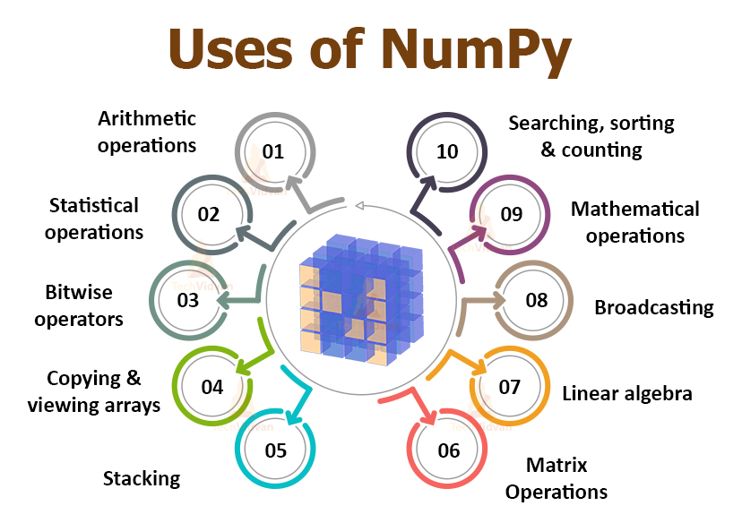
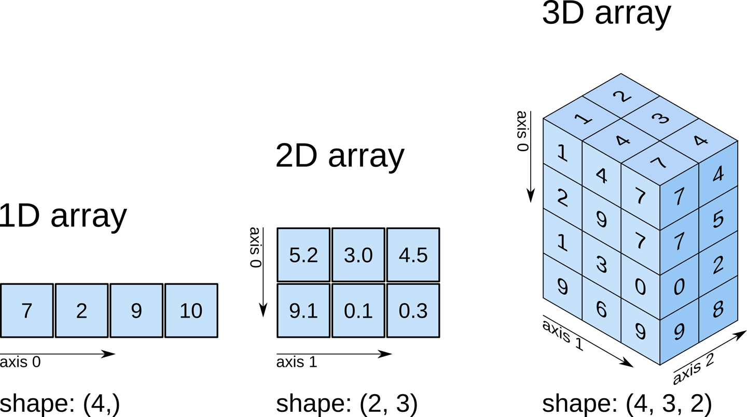
NumPy (“Numerical Python”)
Library that allows us to work with arrays and easily process large amounts of numerical data
Take up less memory
Much faster computations
Easier to do mathematical operations
Notes:
import ____ as __
import numpy as np

Slide 3
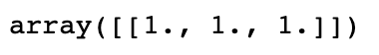
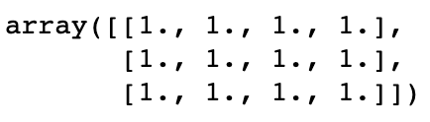
Creating arrays
one array of size 1 (row) by 3 (columns)
Make numpy array of ones: np.ones(size of array)
np.ones((1,3))
np.ones((3,4)) (this is a 2D array!)
Make numpy array of zeros: np.zeros(size of array)
Make numpy array of any value: np.full(size of array, value)
one array of size 3 (rows) by 4 (columns)
General numpy array: np.array([list])
Notes:
(row, column)

Slide 4
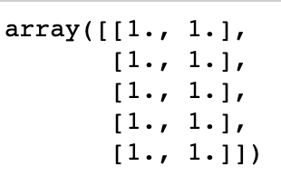
What code do you think produced this array?
np.ones(2,5)
np.ones((2,5))
np.ones((5,2))
np.ones(5,2)
Notes:
error
2 rows of 5 columns
Correct
error

Slide 5
Random number arrays and operations
Make numpy array of random numbers between 0 and 1: np.random.rand(size of array)
Operations we can do to arrays include:
Multiply an array by a number
Add two arrays together (if they are of the same size)
Math operations:
Calculate exponential: np.exp(x)
Calculate square root: np.sqrt(x)
So many more!
Notes:
https://numpy.org/doc/stable/reference/routines.math.html

Slide 6
In notebook 05_numPy-arrays, complete the following section:
1 - Creating numPy arrays
2 - Basic Operations with NumPy arrays

Slide 7
Indexing arrays
Access an array element by using its index number (remember to start counting from 0!)
array1 = np.array([20, 40, 60])
array1[0] will return 20
For 2D arrays, you can access an element by using [row, column]
array2 = np.array([[20, 40], [30, 50]])
array2[0,0] will return 20
What will array2[1,0] return?
 | column 0 | column 1
row 0 | 20 | 40
row 1 | 30 | 50
Notes:
answer: 30

Slide 8
Slicing arrays
Slicing arrays is similar to lists - remember that it slices up to the stopIndex-1
array1 = np.array([20, 40, 60, 80, 100])
array1[0:3] will return [20, 40, 60]
array1[:2] will return [20, 40]
2D array example:
array2 = np.array([[20, 40, 60], [30, 50, 70]])
array2[0,0:2] will return [20, 40]
What will array2[1,:2] return?
 | column 0 | column 1 | column 2
row 0 | 20 | 40 | 60
row 1 | 30 | 50 | 70
Notes:
answer: [30,50]

Slide 9
In notebook 05_numPy-arrays, complete the following sections:
3 - Indexing & Slicing NumPy Arrays
4 - Bonus: NumPy Arrays Applications
When you are done, complete the Exit Ticket!

Slide 10
Average Number of Hours of Daylight in each City
(Answers)
City | Average Number of Hours of Daylight | Range
Berlin | 12.345833 | 9.116667
Canberra | 12.158333 | 4.716666
Beijing | 12.2513895 | 5.6333323
Helsinki | 12.47639 | 13.0
Manila | 12.176388 | 1.7166681

Slide 11
Answer - Maximum Change in Altitude
798.7935458897609 (feet)

